Slide 1
2023-03-01

Slide 2
Today
08:35-08:45 | 9.5: Inheritance Hierarchies
08:45-09:45 | Replit: Inheritance Hierarchies
09:45-10:00 | 9.6: Polymorphism
Friday
09:20-09:30 | 9.6: Polymorphism (if needed)
09:30-10:15 | Replit TBD

Slide 3
9.5: Inheritance Hierarchies

Slide 4
Inheritance Hierarchy
Inheritance allows your program to efficiently share common code between different objects (code reuse); helps you better organize your program in ways that model the real world; and create smaller units of maintenance and testing.
When you use multiple layers of Inheritance in your program you end up with a set of relationships called an Inheritance Hierarchy - most often illustrated as a tree

Slide 5
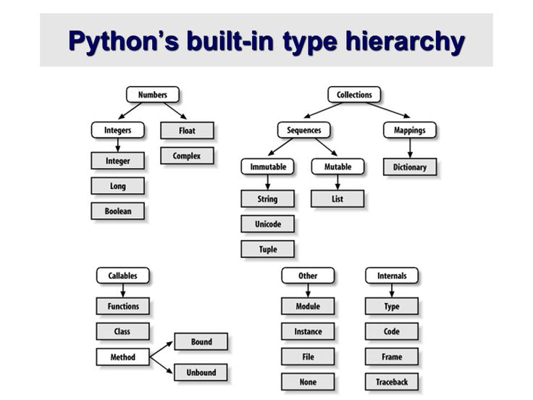

Slide 6
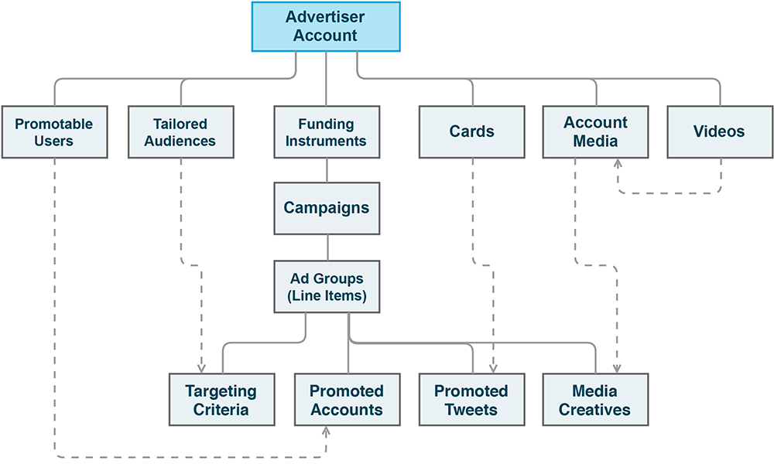
Twitter Ads API Hierarchy

Slide 7
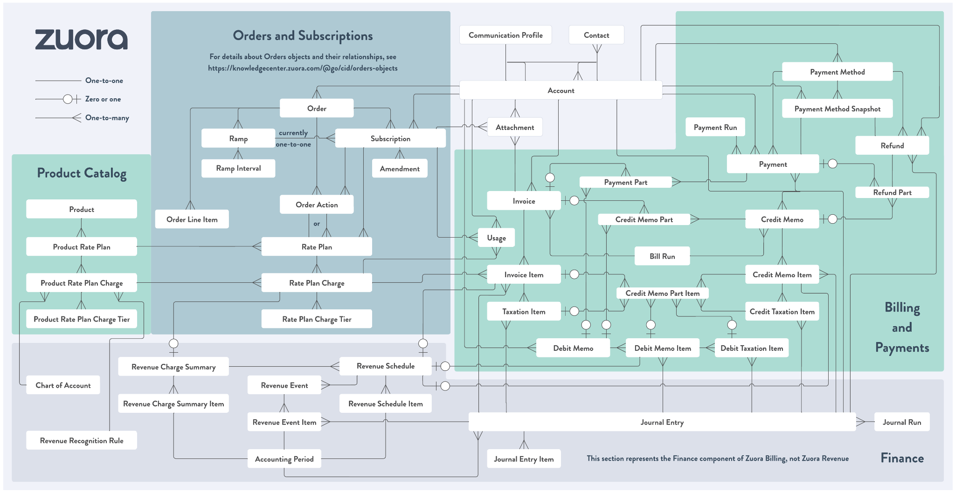

Slide 8
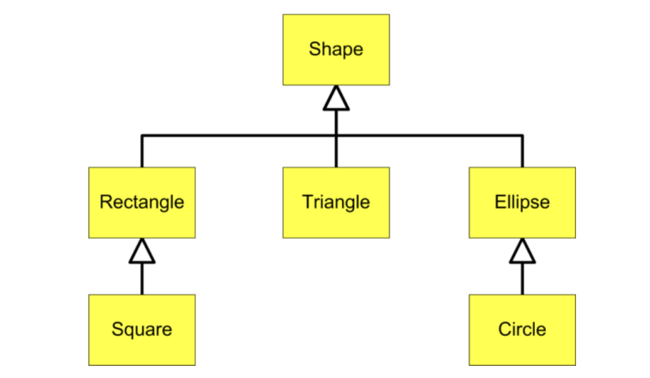
Geometric Shapes

Slide 9
Inheritance Hierarchy
This Inheritance Hierarchy shows the relationships between various geometric shapes.
Remember: In UML (Unified Modeling Language) child classes point to parent classes with open triangle endpoints
Circle is-a Ellipse
Ellipse is-a Shape
Triangle is-a Shape
A Square is-a Rectangle
Rectangle is-a Shape

Slide 10
Inheritance Hierarchy
This Inheritance Hierarchy shows the relationships between various geometric shapes.
Remember: In UML (Unified Modeling Language) child classes point to parent classes with open triangle endpoints
Circle is-a Ellipse
Ellipse is-a Shape
Triangle is-a Shape
A Square is-a Rectangle
Rectangle is-a Shape

Slide 11
Inheritance Hierarchy
This Inheritance Hierarchy shows the relationships between various geometric shapes.
Remember: In UML (Unified Modeling Language) child classes point to parent classes with open triangle endpoints
Circle is-a Ellipse
Ellipse is-a Shape
Triangle is-a Shape
A Square is-a Rectangle
Rectangle is-a Shape

Slide 12
Inheritance Hierarchy
This Inheritance Hierarchy shows the relationships between various geometric shapes.
Remember: In UML (Unified Modeling Language) child classes point to parent classes with open triangle endpoints
Circle is-a Ellipse
Ellipse is-a Shape
Triangle is-a Shape
A Square is-a Rectangle
Rectangle is-a Shape

Slide 13
Inheritance Hierarchy
This Inheritance Hierarchy shows the relationships between various geometric shapes.
Remember: In UML (Unified Modeling Language) child classes point to parent classes with open triangle endpoints
Circle is-a Ellipse
Ellipse is-a Shape
Triangle is-a Shape
A Square is-a Rectangle
Rectangle is-a Shape

Slide 14
Inheritance Hierarchy
This Inheritance Hierarchy shows the relationships between various geometric shapes.
Remember: In UML (Unified Modeling Language) child classes point to parent classes with open triangle endpoints
Circle is-a Ellipse
Ellipse is-a Shape
Triangle is-a Shape
A Square is-a Rectangle
Rectangle is-a Shape

Slide 15
Inheritance Hierarchy
This Inheritance Hierarchy shows the relationships between various geometric shapes.
Remember: In UML (Unified Modeling Language) child classes point to parent classes with open triangle endpoints
Circle is-a Ellipse
Ellipse is-a Shape
Triangle is-a Shape
A Square is-a Rectangle
Rectangle is-a Shape
Circle and Square are also Shapes; They satisfy the is-a relationship test with Shape

Slide 16
Inheritance Hierarchy
The is-a relationship allows you to make use of different types of variable types to hold references to different types of Objects Circle is-a Ellipse Ellipse is-a Shape
Circle c = new Circle() Ellipse e = c; Shape s = c;
Ellipse e = new Ellipse() Shape s = e;

Slide 17
Inheritance Hierarchy
The is-a relationship allows you to make use of different types of variable types to hold references to different types of Objects Circle is-a Ellipse Ellipse is-a Shape
Shape s = new Shape() Rectangle r = s; Triangle t = s; Ellipse e = e;

Slide 18
Inheritance Hierarchy
The is-a relationship allows you to make use of different types of variable types to hold references to different types of Objects Circle is-a Ellipse Ellipse is-a Shape
Circle c = new Circle() Ellipse e = c; Shape s = c;

Slide 19
Inheritance Hierarchy
The is-a relationship allows you to make use of different types of variable types to hold references to different types of Objects Circle is-a Ellipse Ellipse is-a Shape
Circle c = new Circle() Ellipse e = c; Shape s = c;
This means you can create an Array/ArrayList of Shapes and add any one of these Objects to it!

Slide 20
Inheritance Hierarchy
The is-a relationship allows you to make use of different types of variable types to hold references to different types of Objects Circle is-a Ellipse Ellipse is-a Shape
Circle c = new Circle() Ellipse e = c; Shape s = c;
This means you can create an Array/ArrayList of Shapes and add any one of these Objects to it!
Combine this with method overrides and you can build some pretty cool stuff - More on that in the next section!

Slide 21
Inheritance Hierarchy
But this only works in one direction - subclass types can become superclass types; but superclass types cannot become subclass types Circle is-a Ellipse Ellipse is-a Shape
Shape s = new Shape() Rectangle r = s; Triangle t = s; Ellipse e = e;

Slide 22
Inheritance Hierarchy
But this only works in one direction - subclass types can become superclass types; but superclass types cannot become subclass types Circle is-a Ellipse Ellipse is-a Shape
Shape s = new Shape() Rectangle r = s; Triangle t = s; Ellipse e = e;

Slide 23
Inheritance Hierarchy
But this only works in one direction - subclass types can become superclass types; but superclass types cannot become subclass types Circle is-a Ellipse Ellipse is-a Shape
Shape s = new Shape() Rectangle r = s; **ERROR** Triangle t = s; **ERROR** Ellipse e = e; **ERROR**

Slide 24

Inheritance Hierarchy
But this only works in one direction - subclass types can become superclass types; but superclass types cannot become subclass types Circle is-a Ellipse Ellipse is-a Shape
Shape s = new Shape() Rectangle r = s; **ERROR** Triangle t = s; **ERROR** Ellipse e = e; **ERROR**
In this Inheritance Hierarchy there are FIVE subclasses that "could" be a Shape - It is unsafe to assume that a Shape is any one of them!

Slide 25
8:45-9:45 Replit: Inheritance Hierarchies

Slide 26
9.6: Polymorphism

Slide 27
Quick review: compile time vs. runtime
Executing a java program has two steps. First, the program must be compiled (e.g. turned into 1s and 0s that your computer can understand) and then run
The first step of this process is orchestrated by a program called a compiler.
This is the program that yells at you if you try to use a variable before you’ve initialized it
Compilation involves checking a bunch of syntactic “rules” to make sure that your program logic is well-defined
But you can also encounter error messages generated at runtime
For example, an error message that says you tried to divide by zero
These kinds of error can’t be identified a priori–your code needs to be run for these issues to be caught

Slide 28
Polymorphism
In Java when you create an Object with new() - an instance of that specific type is created. The instance will always be an instance of that compile-time type regardless of what its current run-time type is.
class Shape { public void draw() { System.out.println(this.getClass()); } } class Rectangle extends Shape {} class Triangle extends Shape {} class Ellipse extends Shape {}

Slide 29
Polymorphism
In Java when you create an Object with new() - an instance of that specific type is created. The instance will always be an instance of that compile-time type regardless of what its current run-time type is.
class Shape { public void draw() { System.out.println(this.getClass()); } } class Rectangle extends Shape {} class Triangle extends Shape {} class Ellipse extends Shape {} | Shape shapes[] = new Shape[3]; shapes[0] = new Rectangle(); shapes[1] = new Triangle(); shapes[2] = new Ellipse();

Slide 30
Polymorphism
In Java when you create an Object with new() - an instance of that specific type is created. The instance will always be an instance of that compile-time type regardless of what its current run-time type is.
class Shape { public void draw() { System.out.println(this.getClass()); } } class Rectangle extends Shape {} class Triangle extends Shape {} class Ellipse extends Shape {} | Shape shapes[] = new Shape[3]; shapes[0] = new Rectangle(); shapes[1] = new Triangle(); shapes[2] = new Ellipse(); for (Shape s : shapes) { s.draw(); }

Slide 31
Polymorphism
In Java when you create an Object with new() - an instance of that specific type is created. The instance will always be an instance of that compile-time type regardless of what its current run-time type is.
class Shape { public void draw() { System.out.println(this.getClass()); } } class Rectangle extends Shape {} class Triangle extends Shape {} class Ellipse extends Shape {} | Shape shapes[] = new Shape[3]; shapes[0] = new Rectangle(); shapes[1] = new Triangle(); shapes[2] = new Ellipse(); for (Shape s : shapes) { s.draw(); } > ? > ? > ?

Slide 32
Polymorphism
In Java when you create an Object with new() - an instance of that specific type is created. The instance will always be an instance of that compile-time type regardless of what its current run-time type is.
class Shape { public void draw() { System.out.println(this.getClass()); } } class Rectangle extends Shape {} class Triangle extends Shape {} class Ellipse extends Shape {} | Shape shapes[] = new Shape[3]; shapes[0] = new Rectangle(); shapes[1] = new Triangle(); shapes[2] = new Ellipse(); for (Shape s : shapes) { s.draw(); } > class Rectangle > class Triangle > class Ellipse

Slide 33
Polymorphism
In Java when you create an Object with new() - an instance of that specific type is created. The instance will always be an instance of that compile-time type regardless of what its current run-time type is.
The Object instances living in the shapes array have compile-time types of Rectangle, Triangle, and Ellipse (because that is the type that was created with new)
class Shape { public void draw() { System.out.println(this.getClass()); } } class Rectangle extends Shape {} class Triangle extends Shape {} class Ellipse extends Shape {} | Shape shapes[] = new Shape[3]; shapes[0] = new Rectangle(); shapes[1] = new Triangle(); shapes[2] = new Ellipse(); for (Shape s : shapes) { s.draw(); } > class Rectangle > class Triangle > class Ellipse

Slide 34
Polymorphism
In Java when you create an Object with new() - an instance of that specific type is created. The instance will always be an instance of that compile-time type regardless of what its current run-time type is.
class Shape { public void draw() { System.out.println(this.getClass()); } } class Rectangle extends Shape {} class Triangle extends Shape {} class Ellipse extends Shape {} | Shape shapes[] = new Shape[3]; shapes[0] = new Rectangle(); shapes[1] = new Triangle(); shapes[2] = new Ellipse(); for (Shape s : shapes) { s.draw(); } > class Rectangle > class Triangle > class Ellipse
As we perform the for-in loop - each element of shapes is assigned to a Shape variable - this is the run-time type of each Object instance inside the loop (the compile-time class never changes)

Slide 35
Polymorphism
The compiler
Uses the compile-time type to verify that the methods you are trying to use are available to an object of that type.
The code won’t compile if the methods don’t exist in that class or some parent class of that class.
During runtime
Uses the run-time type to determine which methods are used
When a method is called the first place that is checked for that method is the class that created the object. If the method is found there it will be executed. If not, the parent of that class will be checked and so on until the method is found.

Slide 36
Polymorphism
Polymorphic Assignment
Shape s = new Rectangle();
Polymorphic Parameters
public void print(Shape s){}
Polymorphic Collections
Shape[] shapeArray = { new Rectangle(), new Square() };

Slide 37
Polymorphism
Polymorphic Assignment
Shape s = new Rectangle();
Polymorphic Parameters
public void print(Shape s){}
Polymorphic Collections
Shape[] shapeArray = { new Rectangle(), new Square() };
There are no errors at compile-time because the compiler checks that the “subclass is-a superclass” relationship is true.

Slide 38
Polymorphism
Polymorphic Assignment
Shape s = new Rectangle();
Polymorphic Parameters
public void print(Shape s){}
Polymorphic Collections
Shape[] shapeArray = { new Rectangle(), new Square() };
There are no errors at compile-time because the compiler checks that the “subclass is-a superclass” relationship is true.
At run-time, the Java runtime will use the object’s actual subclass type and call the subclass methods for any overridden methods.

Slide 39
Polymorphism
Polymorphic Assignment
Shape s = new Rectangle();
Polymorphic Parameters
public void print(Shape s){}
Polymorphic Collections
Shape[] shapeArray = { new Rectangle(), new Square() };
There are no errors at compile-time because the compiler checks that the “subclass is-a superclass” relationship is true.
At run-time, the Java runtime will use the object’s actual subclass type and call the subclass methods for any overridden methods.
This is why they are polymorphic – the same code can have different results depending on the object’s actual type at run-time.

Slide 40
Replit: Inheritance Hierarchies (Part 2)

Slide 41
Replit: Inheritance Hierarchies (Part 2)
Copy the VerifyShoppingCart.java file (found in Inheritance Hierarchies Part 2) into your Inheritance Hierarchies project
Add the following line to your Main.run function
public void run() { Verify.validateClassesAreDefined(); Verify.validateInheritanceHierarchy(); Verify.validateConstructors(); Verify.validateEggs(); Verify.validateMilk(); VerifyShoppingCart.validateShoppingCart(); System.out.println(""); }
Follow the instructions in VerifyShoppingCart.java

